Slide 1
Update on Prevalence of mcr-like Genes Among Enterobacterales in a Global Surveillance Program: Decline in Occurrence of mcr-1.1 and Emergence of mcr-9.1 and mcr-10.1
Lalitagauri M. Deshpande, Andrew P. Davis, Rodrigo E. Mendes, Mariana Castanheira
JMI Laboratories, North Liberty, Iowa
IDWeek 2020 ⏐ Presentation: 166

Slide 2
Disclosure
Achaogen
Allecra
Allergan
Amplyx
Antabio
Arietis Corp.
Arixa Pharmaceuticals
Astellas Pharma
Athelas
Basilea
Bayer
Boston Pharmaceuticals
Cidara
CorMedix
DePuy Synthes
Destiny Pharma
Discuva Ltd.
Dr. Falk Pharma GmbH
Emery Pharma
Entasis Therapeuticals
Eurofarma Brasil
Fox Chase Chemical
Diversity Center, Inc.
Gateway Pharmaceutical
GenePOC Inc.
Geom Therapeutics, Inc.
GSK
Harvard University
Helperby
HiMedia Laboratories
F. Hoffmann-La Roche
Janssen
ICON plc
Idorsia Pharmaceuticals
Iterum Therapeutics
Laboratory Specialists
Melinta Therapeutics
Merck
Microchem Laboratory
Micromyx
MicuRx Pharmaceuticals
Mutabilis Co.
Nabriva
Pocared
PTC Therapeutics
Rempex
Novartis
NAEJA-RGM
Paratek
Pfizer
Polyphor
Prokaryotics Inc
Qpex Biopharma
Ra Pharmaceuticals
Roivant Sciences
Shionogi
Spero Therapeutics
Summit Pharmaceuticals
Synlogic
Taisho Pharmaceutical
TenNor Therapeutics
Tetraphase
The Medicines Co.
Theravance
VenatoRX
Vyome Therapeutics
Wockhardt
Yukon Pharmaceuticals
Zai Lab
Zavante Therapeutics

Slide 3
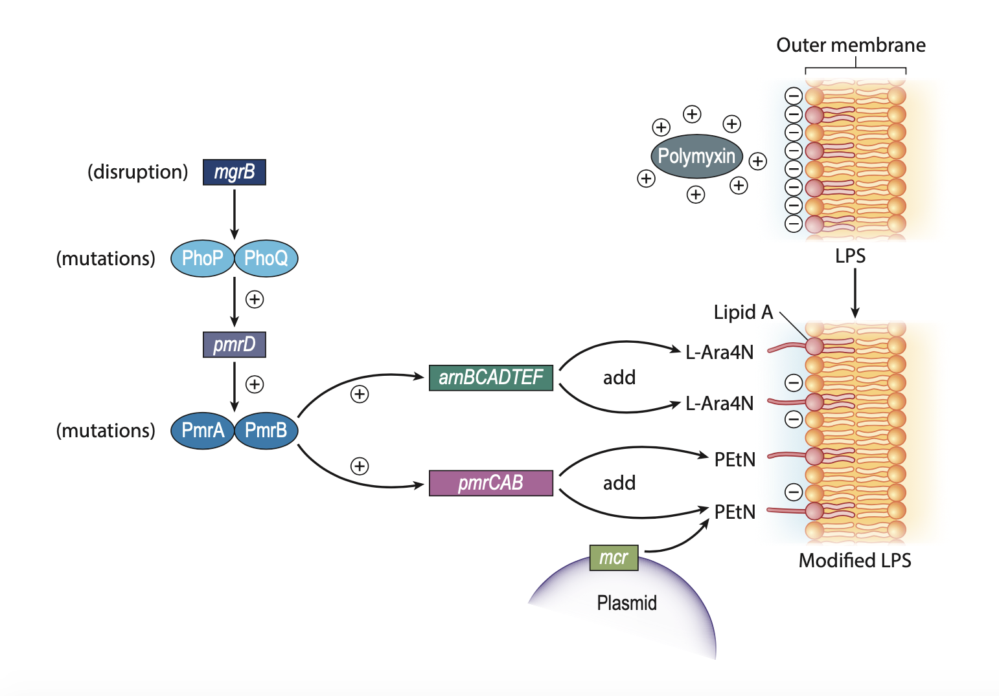
Polymyxin Resistance
  Main cause of resistance is alterations in the components of the LPS biosynthesis pathway
  The plasmid mediated mcr was reported in 2015
  Many studies reporting the emergence in humans, livestock, and food products

Slide 4

Occurrence of mcr-1 E. coli and K. pneumoniae during 2014-2015
Country (City where mcr-1 was observed) | No. of mcr-1 positive isolatesª/No. of colistin-resistant isolates |  | Colistin MIC (µg/mL) for mcr-1 positive isolates
 |  |  | 4 | 8 | >8
All colistin-resistant organisms | 19/390 (4.9%) |  | 10 | 8 | 1
E. coli | 19/59 (32.2%) |  | 10 | 8 | 1
Belgium (Antwerp) | 1/1 |  | 1
Brazil (Florianopolis) | 1/1 |  | 1
Germany (Bonn and Kiel) | 5/10 |  | 2 | 3
Hong Kong | 1/1 |  | 1
Italy (Florence, Milan and Rome) | 4/9 |  | 3 | 1
Malaysia (Kelantan) | 1/1 |  |  | 1
Poland (Warsaw) | 1/2 |  | 1
Russia (Yekaterinburg) | 1/2 |  | 1
Spain (Madrid) | 3/3 |  |  | 2 | 1
USA (New York) | 1/15 |  |  | 1
ª All K. pneumoniae isolates were negative for mcr-1.
Castanheira et al. AAC 2016

Slide 5
Occurrence of mcr-1 and mcr-2ª E. coli and K. pneumoniae during 2016
10 E. coli
United States | 2
Venezuela | 3
Peru | 3
Colombia | 1
Poland | 1
2 K. pneumoniae
Spain | 1
Italy | 1
  New gene: mcr-1.11
ª All isolates were negative for mcr-2.
Deshpande et al. AAC 2019

Slide 6
MCR-8
MCR-4
MCR-1
MCR-10
MCR-9
MCR-7
MCR is a diverse group
MCR-2
MCR-3
MCR-6
MCR-5

Slide 7
Objective
  We screened Enterobacterales isolates collected during 2017 and 2018 from the SENTRY Antimicrobial Surveillance Program for mcr variants using whole genome sequencing (WGS)

Slide 8
Methods
  A total of 36,504 Enterobacterales isolates were susceptibility tested by reference broth microdilution (CLSI; M07, 2018) for colistin and comparator antimicrobial agents.
  A total of 4,642 were submitted to whole genome sequencing due to MIC values ≥2 mg/L for:
    Any 2 of the following agents: ceftazidime, ceftriaxone, aztreonam and cefepime for Klebsiella pneumoniae, K. oxytoca, Escherichia coli, Enterobacter cloacae species complex, and Citrobacter spp.
    Imipenem and meropenem for all Enterobacterales
  DNA sequences were de novo assembled and contigs were blasted against a local database for mcr-1.1 through mcr-10.1 and subtypes.

Slide 9
Results
  A total of 128 (2.8%) isolates carried mcr genes among the 4,642 isolates sequenced.
  These isolates were collected in 33 countries.
Organisms (No. of isolates) | mcr-1.1 | mcr-1.12 | mcr-1.2 | mcr-1.5 | mcr-3.1 | mcr-3.14 | mcr-3.5 | mcr-4.3 | mcr-8.1 | mcr-9.1 | mcr-9.1, mcr-4.3 | mcr-10.1
All Enterobacterales (128) | 12 | 1 | 1 | 1 | 1 | 1 | 1 | 1 | 1 | 91 | 1 | 16
Citrobacter freundii species complex (4) |  |  |  |  |  |  |  |  |  | 4
Enterobacter cloacae species complex (89) |  |  |  |  |  |  |  | 1 |  | 72 | 1 | 15
Escherichia coli (16) | 9 | 1 | 1 | 1 | 1 |  |  |  |  | 3
Klebsiella oxytoca (6) |  |  |  |  |  |  |  |  |  | 6
Klebsiella pneumoniae (13) | 3 |  |  |  |  | 1 | 1 |  | 1 | 6 |  | 1

Slide 11
Resistance mechanisms in MCR producing isolates
Aminoglycosides |  |  | ESBL/pAmpC |  |  | Carbapenemases |  |  | Fosfomycin |  |  | Phenicols |  |  | Quinolones |  |  | Trimethoprim/ sulfonamides |  |  | Tetracyclines
aac(3)-IIa, aac(6`)-IIc | 9 |  | SHV-12 | 33 |  | KPC-3 | 7 |  | fosA | 6 |  | catA2 | 27 |  | qnrB2 | 14 |  | dfrA19, sul1, sul2 | 23 |  | tet(D) | 19
aph(3`)-Ia | 9 |  | CTX-M-9 | 6 |  | VIM-1 | 4 |  | fosA3 | 1 |  | catB3 | 5 |  | qnrA1 | 12 |  | dfrA19, sul1 | 12 |  | tet(A) | 16
aac(3)-IIa, aac(6`)-Ib, aac(6`)-IIc | 7 |  | CTX-M-9, SHV-12 | 5 |  | KPC-2 | 1 |  | fosA4 | 2 |  | catA1 | 3 |  | qnrB4 | 5 |  | sul1 | 12 |  | tet(B) | 4
aac(3)-IIa, aac(6`)-Ib, aac(6`)-IIc, aph(3`)-Ia | 7 |  | CTX-M-15, OXA-1_OXA-30 | 4 |  | NDM-1 | 1 |  |  |  |  | catA2, catB3 | 2 |  | qnrB1 | 4 |  | dfrA16, sul1 | 5 |  | tet(A), tet(D) | 2
ant(2``)-Ia | 5 |  | CTX-M-55 | 3 |  | OXA-181 | 1 |  |  |  |  | catB | 2 |  | qnrS1 | 4 |  | dfrA14, sul2 | 3 |  | tet(A), tet(B) | 1
aac(3)-IIa, aac(6`)-IIc, aph(3`)-Ia | 3 |  | CTX-M-15 | 2 |  | OXA-48 | 1 |  |  |  |  | cmlA4 | 2 |  | qnrB38 | 3 |  | dfrA14, dfrA19, sul1, sul2 | 2 |  | tet(B), tet(D) | 1
aac(6`)-Ib, ant(2``)-Ia | 3 |  | CTX-M-15, OXA-1_OXA-30, SHV-12 | 2 |  |  |  |  |  |  |  | catA1, catA3 | 1 |  | oqxA, oqxB19, qnrB2 | 2 |  | dfrA14, sul1 | 2
ant(2``)-Ia, ant(3``)-Ia | 3 |  | DHA-1, SHV-12 | 2 |  |  |  |  |  |  |  | catA1, cmlA1 | 1 |  | oqxA, oqxB, qnrB4 | 1 |  | dfrA15, dfrA25, sul1, sul2 | 2
aac(3)-IIa, aac(6`)-Ib-cr, aac(6`)-IIc | 2 |  | OXA-1_OXA-30, SHV-12 | 2 |  |  |  |  |  |  |  | catA1, floR | 1 |  | oqxA, oqxB19 | 1 |  | dfrA17, sul1, sul2 | 2
aac(3)-IId | 2 |  | SHV-5 | 2 |  |  |  |  |  |  |  | catA2, cmlA1 | 1 |  | oqxA, oqxB19, qnrB1 | 1 |  | dfrA17, sul1, sul2, sul3 | 2
aac(6`)-Ib-cr, ant(2``)-Ia | 2 |  | SHV-7 | 2 |  |  |  |  |  |  |  | catB11, catB3 | 1 |  | oqxA, oqxB19, qnrS1 | 1 |  | dfrA8, sul2 | 2
aac(6`)-Ib4, ant(2``)-Ia | 2 |  | CMY-2 | 1 |  |  |  |  |  |  |  | catB2 | 1 |  | oqxA, oqxB25, qnrB2 | 1 |  | sul2 | 2
ant(3``)-Ia | 2 |  | CMY-2, CTX-M-55 | 1 |  |  |  |  |  |  |  | cmlA5, floR | 1 |  | oqxA, oqxB25, qnrS1 | 1 |  | dfrA1 | 1
aac(3)-IIa | 1 |  | CMY-2, SHV-12 | 1 |  |  |  |  |  |  |  | floR | 1 |  | oqxA, oqxB32, qnrA1, qnrS1 | 1 |  | dfrA1, sul1, sul3 | 1
aac(3)-IIa, aac(3)-IId, aac(6`)-Ib, aac(6`)-IIc | 1 |  | CTX-M-15, CTX-M-9, OXA-1_OXA-30, SHV-12 | 1 |  |  |  |  |  |  |  |  |  |  | oqxA, oqxB32, qnrB2 | 1 |  | dfrA12, dfrA14, sul1, sul2 | 1
aac(3)-IIa, aac(6`)-Ib-cr | 1 |  | CTX-M-15, DHA-1 | 1 |  |  |  |  |  |  |  |  |  |  | oqxA, qnrA1 | 1 |  | dfrA12, dfrA19, sul1, sul2 | 1
aac(3)-IIa, aac(6`)-Ib-cr, ant(2``)-Ia | 1 |  | CTX-M-2 | 1 |  |  |  |  |  |  |  |  |  |  | oqxA, qnrB1 | 1 |  | dfrA12, sul1 | 1
aac(3)-IIa, aac(6`)-Ib-cr5, aac(6`)-IIc | 1 |  | CTX-M-3 | 1 |  |  |  |  |  |  |  |  |  |  | qnrA1, qnrB4 | 1 |  | dfrA12, sul3 | 1
aac(3)-IIa, ant(3``)-Ia, aph(3`)-Ia | 1 |  | CTX-M-3, DHA-1 | 1 |  |  |  |  |  |  |  |  |  |  |  |  |  | dfrA14, dfrA16, sul1, sul2 | 1
aac(3)-IIa, aph(3`)-Ia | 1 |  | CTX-M-65 | 1 |  |  |  |  |  |  |  |  |  |  |  |  |  | dfrA14, sul1, sul2 | 1
aac(3)-IId, ant(3``)-Ia | 1 |  | DHA-1, OXA-1_OXA-30 | 1 |  |  |  |  |  |  |  |  |  |  |  |  |  | dfrA15, dfrA19, sul1 | 1
aac(3)-IId, aph(3`)-Ia | 1 |  | DHA-1, OXA-1_OXA-30, SHV-12 | 1 |  |  |  |  |  |  |  |  |  |  |  |  |  | dfrA16, sul1, sul2 | 1
aac(6`)-Ib | 1 |  | OXA-4 | 1 |  |  |  |  |  |  |  |  |  |  |  |  |  | dfrA17, sul1, sul3 | 1
aac(6`)-Ib-cr, ant(3``)-Ia | 1 |  |  |  |  |  |  |  |  |  |  |  |  |  |  |  |  | dfrA19 | 1
aac(6`)-Ib-cr, aph(3`)-Ia | 1 |  |  |  |  |  |  |  |  |  |  |  |  |  |  |  |  | dfrA27, sul1 | 1
aac(6`)-Ib, ant(2``)-Ia, aph(3`)-Ia | 1 |  |  |  |  |  |  |  |  |  |  |  |  |  |  |  |  | dfrB1, sul1 | 1
aac(6`)-Ib, ant(3``)-Ia | 1 |  |  |  |  |  |  |  |  |  |  |  |  |  |  |  |  | sul1, sul2 | 1
aac(6`)-Ib, aph(3`)-Ia | 1
aac(6`)-Ib, aph(3`)-Ia, aph(3`)-IIa, rmtF2 | 1
aac(6`)-Ib, rmtF1 | 1
aac(6`)-Ib`, ant(2``)-Ia, ant(3``)-Ia, aph(3`)-Ia | 1
ant(3``)-Ia, aph(3`)-Ia | 1

Slide 12
Resistance mechanisms in MCR producing isolates
 | C. freundii | E. cloace | E. coli | K. oxytoca | K. pneumoniae | C. freundii | E. cloace | E. coli | K. oxytoca | K. pneumoniae | C. freundii | E. cloace | E. coli | K. oxytoca | K. pneumoniae | C. freundii | E. cloace | E. coli | K. oxytoca | K. pneumoniae | C. freundii | E. cloace | E. coli | K. oxytoca | K. pneumoniae | C. freundii | E. cloace | E. coli | K. oxytoca | K. pneumoniae | C. freundii | E. cloace | E. coli | K. oxytoca | K. pneumoniae | C. freundii | E. cloace | E. coli | K. oxytoca | K. pneumoniae
MCR-1.1 |  |  |  |  |  |  |  |  |  |  |  |  |  |  |  |  |  |  |  |  |  |  |  |  |  |  |  |  |  |  |  |  |  |  |  |  |  |  |  |  |  |  | >30 isolates
MCR-1.12 |  |  |  |  |  |  |  |  |  |  |  |  |  |  |  |  |  |  |  |  |  |  |  |  |  |  |  |  |  |  |  |  |  |  |  |  |  |  |  |  |  |  | 20-30 isolates
MCR-1.2 |  |  |  |  |  |  |  |  |  |  |  |  |  |  |  |  |  |  |  |  |  |  |  |  |  |  |  |  |  |  |  |  |  |  |  |  |  |  |  |  |  |  | 10-20 isolates
MCR-1.5 |  |  |  |  |  |  |  |  |  |  |  |  |  |  |  |  |  |  |  |  |  |  |  |  |  |  |  |  |  |  |  |  |  |  |  |  |  |  |  |  |  |  | 1-10 isolates
MCR-10.1
MCR-3.1
MCR-3.14
MCR-3.5
MCR-4.3
MCR-8.1
MCR-9.1
MCR-9.1, MCR-4.3
All MCR
 | Aminoglycosides |  |  |  |  | ESBL/pAmpC |  |  |  |  | Carbapenemases |  |  |  |  | Fosfomycin |  |  |  |  | Phenicols |  |  |  |  | Quinolones |  |  |  |  | Trimethoprim/ sulfonamides |  |  |  |  | Tetracyclines

Slide 13
Colistin MIC values for mcr-carrying isolates

Slide 14
Susceptibility profile of mcr-carrying isolates

Slide 15
Prevalence of mcr genes in the SENTRY Program

Slide 16
Conclusions
  We have monitored mcr-like genes in the SENTRY Antimicrobial Surveillance Program since 2014 among colistin-resistant E. coli and K. pneumoniae isolates
  In 2017-2018, we observed 128/4,246 (2.7%) mcr-carrying isolates among isolates resistant to cephalosporins and carbapenems included only 17.5% (n=744) colistin resistant isolates
  We observed an exponential increase of mcr-9.1 after 2015.
2014-2015 |  | 2016
4.9% (19/390) E. coli and K. pneumoniae |  | 6.0% (12/199) E. coli and K. pneumoniae
32.2% (19/59) E. coli

Slide 17
Conclusions
  Most isolates carrying mcr-9.1 were E. cloacae species complex that had low colistin MIC values (≤0.06 to 1 mg/L).
    This gene was observed in isolates from 21 countries.
  The initial mcr-9.1 report was from a colistin-susceptible Salmonella enterica serotype Typhimurium, but cloning this gene demonstrated that it could cause resistance.
  mcr-9.1-harboring isolates carried more resistance genes and were more resistant to several antimicrobial agents when compared to isolates carrying other mcr variants.
  Isolates harboring mcr-9.1 should be monitored and the impact of this gene in colistin resistance should be further investigated.
Carroll et al., mBio 2019
Kieffer et al., AAC 2019

Slide 18
Acknowledgements
  We received no funding for this study.
  The authors would like to thank the SENTRY Antimicrobial Surveillance Program participants.

Slide 19


