Slide 1
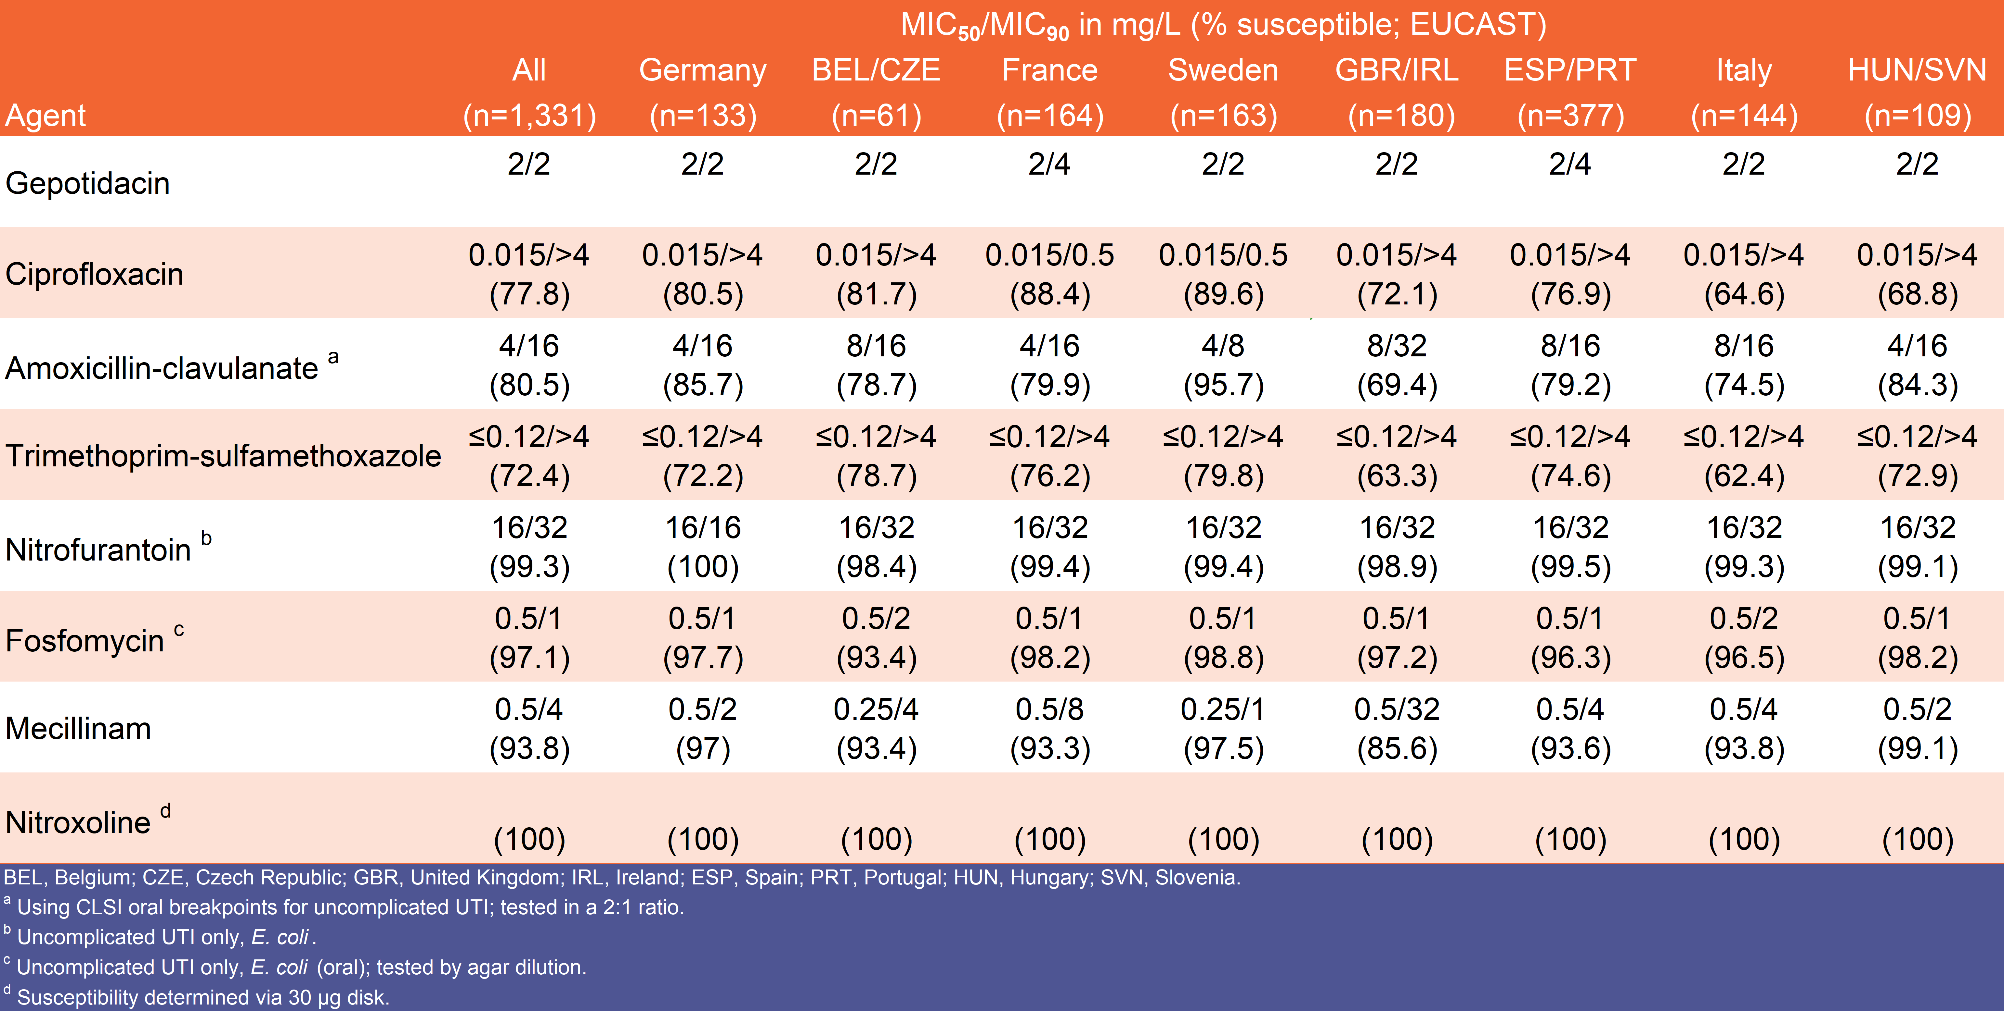
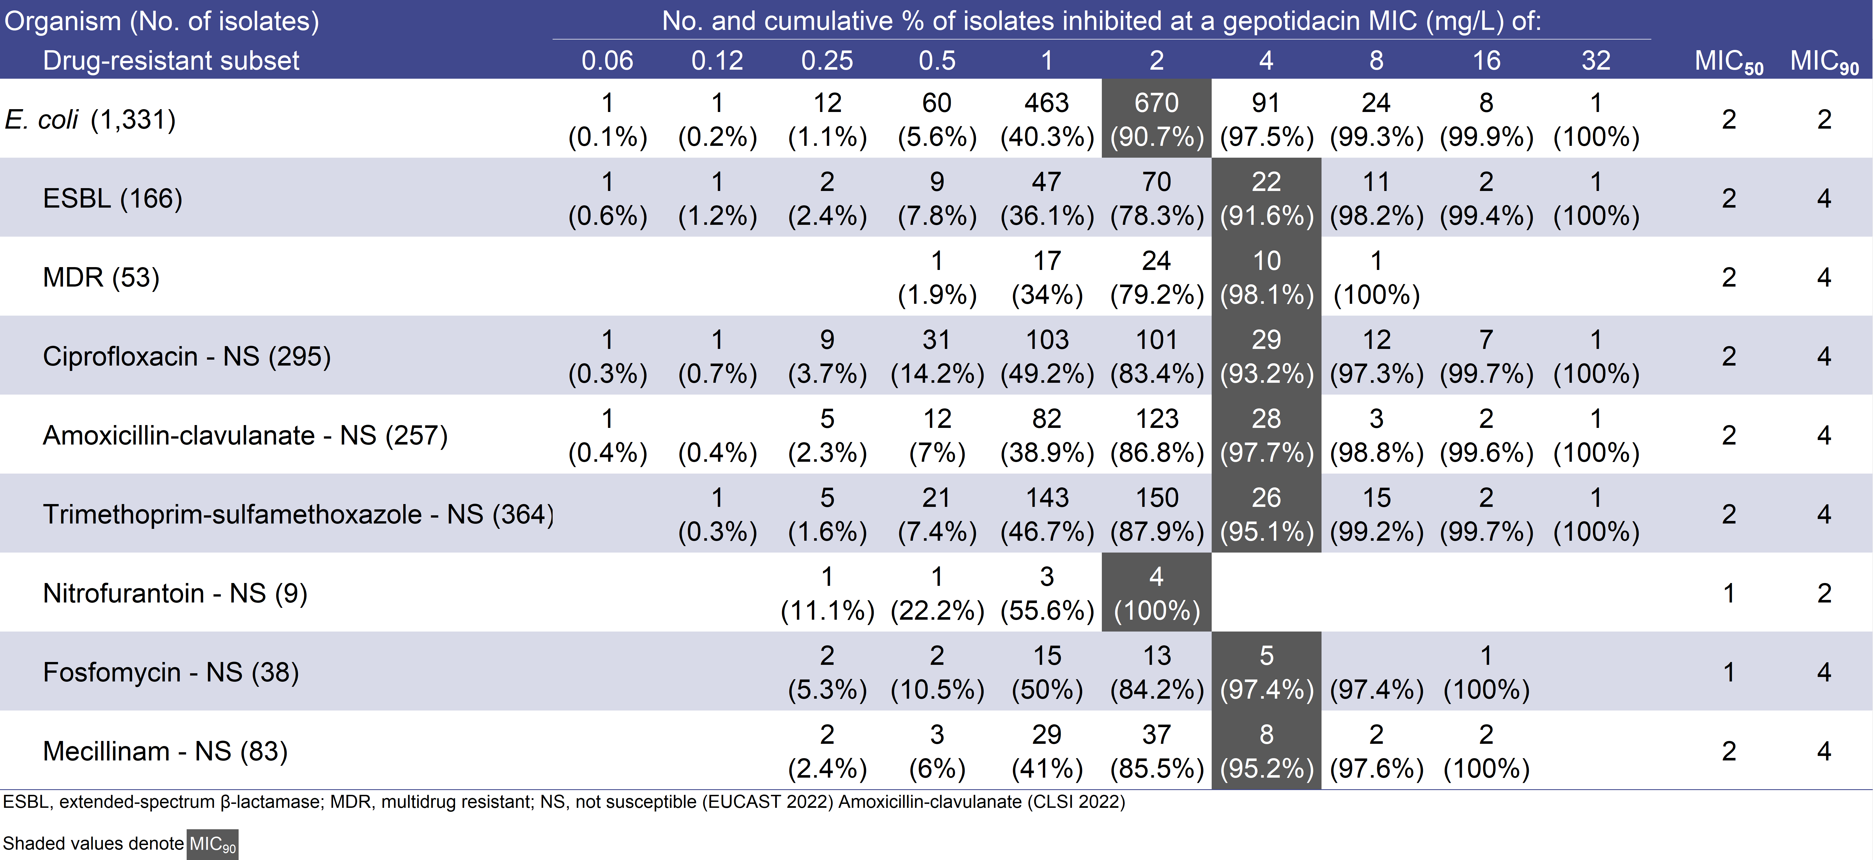
Activity of gepotidacin against Escherichia coli isolates from urinary tract infections collected between 2019–2021 from Germany and other European countries
Results
Gepotidacin demonstrated potent in vitro activity against contemporary E. coli isolates from Germany as well as 11 other European countries.
Gepotidacin inhibited 91.6% of ESBL and 98.1% of MDR isolates from all 12 European countries at concentrations ≤4 mg/L.
For some comparators, the susceptibility of isolates from Germany was similar to other countries, while others displayed more variability.
Gepotidacin was active against 133 E. coli isolates from Germany (MIC_{50/90}, 2/2 mg/L), with 96.2% of these isolates inhibited at concentrations ≤4 mg/L.
Minimal variability in gepotidacin activity was observed against isolates from Germany and the other 11 European countries.
Gepotidacin MIC₅₀ values were 2 mg/L and MIC₉₀ values ranged from 2-4 mg/L (Table 1).
Among isolates from Germany, susceptibility (S) to comparators trimethoprim-sulfamethoxazole (72.2% S), ciprofloxacin (80.5% S), amoxicillin-clavulanic acid (85.7% S), mecillinam (97.0% S), fosfomycin (97.7% S), nitrofurantoin (100% S), and nitroxoline (100% S) was observed (Table 1).
Across isolates from all 12 European countries, lower susceptibilities and larger variation were observed for some comparators.
Ciprofloxacin (64.6-89.6% S), amoxicillin-clavulanic acid (69.4–95.7% S), trimethoprim-sulfamethoxazole (62.4–79.8% S).
While other comparators remained active.
Mecillinam (85.6–99.1% S), fosfomycin (93.4-98.8% S), nitrofurantoin (98.4-100.0% S), and nitroxoline (100.0% S).
When tested against the drug-resistant subsets from all 12 European countries, including ESBL (12.5% of total) and MDR (4.0% of total) subsets, gepotidacin maintained similar MIC₅₀ values (ranging from 1-2 mg/L) and MIC₉₀ values (ranging from 2-4 mg/L; Table 2).
¹S. J. Ryan Arends, ²C. Ress, ²D. Butler, ²N. Scangarella-Oman, ¹R. E. Mendes
¹JMI Laboratories, North Liberty, Iowa, USA
²GlaxoSmithKline, Collegeville, Pennsylvania, USA
³GlaxoSmithKline, Munich, Germany
Introduction
Gepotidacin (GSK2140944) is a novel, bactericidal, first in class triazaacenaphthylene antibiotic in clinical development for the treatment of gonorrhea and uncomplicated urinary tract infection (acute cystitis).
Gepotidacin selectively inhibits bacterial DNA replication by a distinct mechanism of action, which confers in vitro activity against most strains of target pathogens, such as E. coli, S. saprophyticus, and N. gonorrhoeae, including those strains resistant to current antibiotics.
This study reports on the in vitro activity of gepotidacin and comparator agents when tested against contemporary E. coli clinical isolates from patients with UTIs in Germany 11 other European countries.
Table 1 Activity of gepotidacin and comparator antimicrobial agents tested against 1,331 E. coli isolates
Table 2 Distribution of MIC values for gepotidacin against isolate subsets with resistance to oral agents
Materials and Methods
A total of 1,331 E. coli isolates were collected from 6 medical centres in Germany (133 isolates) and 21 other sites in 11 other countries, including Belgium (19 isolates), the Czech Republic (42), France (164), Hungary (28), Ireland (33), Italy (144), Portugal (63), Slovenia (81), Spain (314), Sweden (163), and the United Kingdom (147).
Isolates recovered from patients with UTIs, 70.7% of which were from ambulatory, emergency, family practice, and outpatient services.
All isolates were tested for susceptibility by CLSI methods.
MIC results for all comparators except amoxicillin-clavulanic acid were interpreted per EUCAST guidelines.
Amoxicillin-clavulanic acid was tested at a 2:1 ratio and MICs were interpreted using CLSI breakpoints.
Susceptibility to fosfomycin and mecillinam was determined by agar dilution.
Fosfomycin testing was supplemented with glucose-6-phosphate (25 mg/L).
Nitroxoline susceptibility was determined via disk diffusion.
The extended-spectrum β-lactamase (ESBL) phenotype in E. coli was characterized by isolates displaying aztreonam, ceftazidime, or ceftriaxone MIC values ≥ 2 mg/L.
Multidrug resistant (MDR) phenotype was defined for E. coli as described by Magiorakos et al. as having a CLSI not susceptible phenotype to 3 or more drug classes from the following: extended-spectrum cephalosporins (ceftriaxone or ceftazidime); carbapenems (meropenem); antipseudomonal penicillins + β-lactamase inhibitors (piperacillin-tazobactam); fluoroquinolones (ciprofloxacin or levofloxacin); aminoglycosides (gentamicin or amikacin).
CLSI. M07ED11. Methods for dilution antimicrobial susceptibility tests for bacteria that grow aerobically: eleventh edition. Wayne, PA, Clinical and Laboratory Standards Institute, 2018.
CLSI. M100Ed32. Performance standards for antimicrobial susceptibility testing: 32nd informational supplement. Wayne, PA, Clinical and Laboratory Standards Institute, 2022.
EUCAST (2022). Breakpoint tables for interpretation of MICs and zone diameters. Version 12.0, January 2022
Magiorakos AP, et al. (2012) Multidrug-resistant, extensively drug-resistant and pandrug-resistant bacteria: an international expert proposal for interim standard definitions for acquired resistance. Clin. Microbiol. Infect. 18: 268-281.10.1111/j.1469-0691.2011.03570.x
S. J. Ryan Arends, PhD
JMI Laboratories
345 Beaver Kreek Centre, Suite A
North Liberty, Iowa 52317
Phone: (319) 665-3370
Fax: (319)665-3371
Email: ryan-arends@jmilabs.com
This project has been funded in whole or in part with Federal funds from the Office of the Assistant Secretary for Preparedness and Response, Biomedical Advanced Research and Development Authority, under OTA Agreement No. HHSO100201300011C.
This study at JMI Laboratories was supported by GlaxoSmithKline and JMI received compensation for poster preparation.
74th Congress of the German Society for Urology
September 21–24, 2022, Hamburg

